Slide 1
RAJA RAJESHWARI M
Final Project
3/21/2024 Annual Review

Slide 2
PROJECT TITLE
Customer Segmentation
for Targeted Marketing
using Decision Trees
3/21/2024 Annual Review

Slide 3


AGENDA
1.Introduction to Customer Segmentation
2.Overview of the project
3.Identification of End Users
4.Our Solution and its value proposition
5.The Wow Factor in Our Solution
6.Modelling Approach
7.Results and Performance Evaluation
3/21/2024 Annual Review

Slide 4

PROBLEM STATEMENT
In today's competitive market landscape, understanding customer behavior is crucial for businesses aiming to tailor their marketing strategies effectively. Customer segmentation, a fundamental practice in marketing analytics, allows businesses to group customers with similar characteristics together, enabling targeted and personalized marketing campaigns. Decision trees, as a predictive modeling technique, offer a powerful tool for segmenting customers based on various attributes.
3/21/2024 Annual Review

Slide 5

PROJECT OVERVIEW
Customer segmentation is a critical aspect of marketing strategy, allowing businesses to categorize their customer base into distinct groups based on shared characteristics. This segmentation enables targeted and personalized marketing efforts, ultimately leading to improved customer engagement and satisfaction. Decision trees, a popular machine learning algorithm, offer a robust approach to segmenting customers based on various attributes. This project aims to leverage decision trees for customer segmentation to facilitate targeted marketing strategies.
3/21/2024 Annual Review

Slide 6

WHO ARE THE END USERS?
1.Marketing Managers
2.Sales Teams
3.Product Managers
4.Customer Service Representatives
5.Business Analysts
6.Executives and Stakeholders
7.Market Researchers
3/21/2024 Annual Review

Slide 7

YOUR SOLUTION AND ITS VALUE PROPOSITION
The solution involves leveraging decision tree algorithms to segment customers based on various attributes such as purchase history, online behavior, and more. The process consists of data collection, preprocessing, feature selection, model training, and evaluation. Decision tree models are trained using historical customer data to identify distinct customer segments. These segments are then analyzed to derive actionable marketing strategies tailored to each group's preferences and behaviors
3/21/2024 Annual Review

Slide 8

THE WOW IN YOUR SOLUTION
1.Personalization: The segmentation process using decision trees allows businesses to personalize marketing strategies for each customer segment.
2.Adaptability: Decision tree models can adapt to changing market dynamics and customer behavior patterns over time.
3.Precision and Accuracy: Decision trees offer a powerful method for segmenting customers with remarkable precision
3/21/2024 Annual Review

Slide 9
MODELLING
1. Data Collection and Preparation: Gather customer data from various sources such as CRM systems, transaction records, website interactions, demographic information, etc.
2. Feature Selection: Identify relevant customer attributes (features) that are likely to contribute to segmentation, such as demographics, purchase history, browsing behavior, etc.
3. Splitting the Data: Divide the dataset into training and testing sets to evaluate the performance of the decision tree model.
3/21/2024 Annual Review

Slide 10
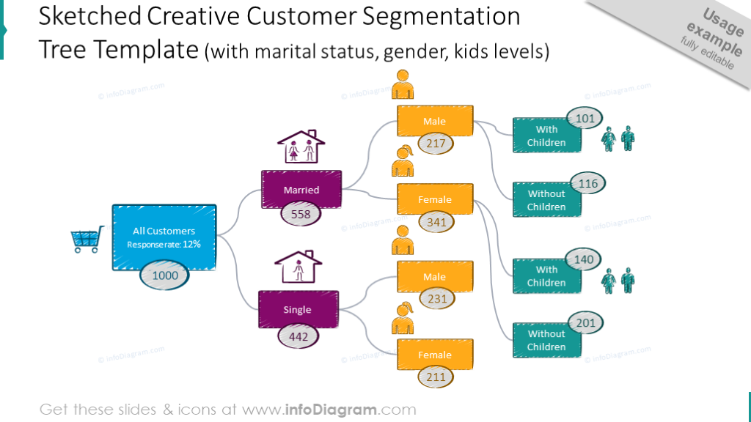
4. Training the Decision Tree Model: Select a decision tree algorithm (e.g., CART, ID3, C4.5) and configure its hyperparameters (e.g., maximum depth, minimum samples per leaf).
5. Model Evaluation: Evaluate the trained decision tree model using the testing data.
6. Predictive Modeling: Apply the trained decision tree model to new, unseen customer data to predict the segment/category of each customer.
7. Monitoring and Iteration: Update the decision tree model periodically with new data to ensure its relevance and effectiveness in segmentation.

Slide 11
RESULTS
The application of decision trees for customer segmentation in targeted marketing has yielded insightful results, providing a comprehensive understanding of our customer base. Through rigorous analysis of various attributes and behaviors, distinct customer segments have been identified, each representing unique demographics, preferences, and purchasing behaviors.
Overall, customer segmentation using decision trees enhances our ability to target marketing initiatives effectively, driving improved customer engagement, satisfaction, and ultimately, business growth.
3/21/2024 Annual Review

